Slide 1
Carotid artery pathway
Introduction
Divisions of common carotid artery
Divisions of external carotid artery and areas of supply
Internal carotid artery pathway and segments
Branches from the segments of internal carotid artery
Applied anatomy

Slide 2
The common carotid artery of left and right sides are asymmetrical in origin. The left common carotid artery arises from the left side from the arch of aorta in the thoracic cavity ascending to lie in front of left subclavian artery up to sternoclavicular joint. On the right side of arch of aorta arises the brachiocephalic trunk which bifurcates behind the right sternoclavicular joint into the right common carotid and right subclavian arteries. The common carotid arteries of both sides gives no branches proximal to their origins. The common carotid arteries lie within carotid sheath bearing three structures, the artery to the medial and vein to the left while the vagus nerve lie in between them.

Slide 3
The common carotid artery divides into external and internal carotid arteries. They both originate from a point called the carotid bifurcation which is variably situated at a level between the third and fourth, or fourth and fifth cervical vertebrae (C3-C4/C4-C5). This point of bifurcation usually corresponds to upper border of thyroid cartilage lamina (upper border of C4).
Situated close to the carotid bifurcation is an anatomical structure called carotid sinus generally located at C4. The carotid sinus or bulb is a dilation acting as a baroreceptor for detecting blood pressure changes,

Slide 4
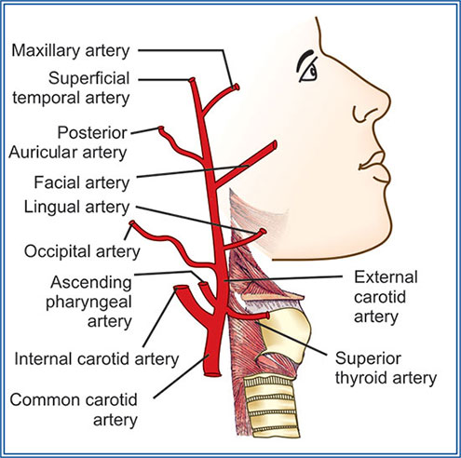
External carotid artery: At its commencement from the common carotid artery lies at the side of wall of the pharynx somewhat anterior medial to internal carotid. It ascends in front of the artery deep to the posterior belly of digastric and stylohyoid and above it pierces the deep lamina of parotid fascia to enter the gland. Within the gland behind the neck of the mandible it divides into the terminal branches, maxillary and superficial temporal arteries. Before it divides into the two terminal branches, it gives off six branches. Three from the front, two from behind and one from the deep part.

Slide 5
The three from the front are; superior thyroid, lingual and facial which diverge widely. The two from behind are occipital and posterior auricular which pass up deep and posterior to the posterior digastric respectively. The branch from the medial side is the ascending pharyngeal which ascends to the base of the skull on the side wall of he pharynx long side the internal carotid.

Slide 6
Superior thyroid artery is the first branch of the external carotid artery. It arises from the external carotid artery at the level of the hyoid bone. It descends from the anterior surface of the external carotid artery along the lateral border of the thyrohyoid muscle towards the apex of the thyroid gland. Supplies; sternocleidomastoid, cricothyroid and infrahyoid strap muscles.

Slide 7
Ascending pharyngeal artery arises from the medial surface of the external carotid artery between the internal carotid artery and pharynx to reach the base of the cranium. Ascending pharyngeal artery supply include the pharynx, soft palate, the ear, meninges, muscles of the neck.
Lingual artery arises from the anteromedial aspect of the external carotid artery at the level of the great cornu between the superior thyroid and facial arteries. The lingual artery provides arterial supply to the tongue and floor of the mouth.
Facial artery emerges just above the lingual artery within the carotid triangle. It travels deep to the digastric and stylohyoid muscles, curving around the inferior border of the mandible to enter the face. ​Supplies all structures in the face from the inferior border of the mandible anterior to the masseter muscle to the medial corner of the eye that includes soft palate, palatine tonsil, auditory tube and submandibular gland.

Slide 8
Occipital artery courses posterior and superiorly, deep to the posterior belly of the digastric muscle, passes between the transverse process of the atlas (C1) and pierces the investing layer of deep cervical fascia to ascend within the dense superficial fascia of the scalp. Supplies sternocleidomastoid, trapezius, deep muscles of the neck, the meninges, pinna of the ear and mastoid air cells.
Posterior auricular artery arises from the posterior aspect of the external carotid artery. Supplies digastric, stylohyoid and sternocleidomastoid muscles and parotid gland.
Maxillary artery, larger of the two terminal branches arises from the external carotid artery within the parotid gland. It is divided into three parts. Branches of the first part include: middle meningeal, inferior alveolar, deep auricular, anterior tympanic and accessory meningeal arteries.

Slide 9
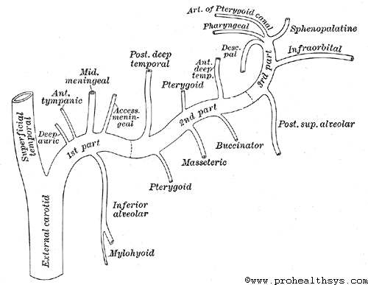
Branches of the second part include: the deep temporal, masseteric, buccal and pterygoid arteries.
Branches of the third part include: posterior superior alveolar, infraorbital, pharyngeal, descending palatine, sphenopalatine arteries and artery of the pterygoid canal.
Superficial temporal artery arises as the smaller terminal branch of external carotid artery. Similarly arises within the substance of the parotid gland behind the neck of the mandible. Branches; transverse facial, zygoatico orbital and middle temporal arteries, parotid anterior auricular.

Slide 10
Internal carotid artery: It is the terminal part of common carotid artery. It arises around the level of 4th cervical vertebral where the common carotid bifurcates and lying deeper to its external counterpart. The pathway is divided into segments that include the following:
C1 – Cervical Segment
C2 – Petrous Segment
C3 – Lacerum Segment
C4 – Cavernous Segment
C5 – Clinoid Segment
C6 – Ophthalmic (Supraclinoid) Segment
C7 – Communicating (Terminal) Segment

Slide 11
C1, Cervical segment: It extends from the carotid bifurcation until it enters the carotid canal in the skull anterior to the jugular foramen. At its origin it is somewhat dilated known as the carotid sinus. It runs vertically upward in the carotid sheath and enters the skull through carotid canal. During its course it lies in front of transverse processes of upper three cervical vertebrae.
C2, Petrous segment: From the entrance to the carotid canal of petrous part temporal bone, the artery extends across to foramen lacerum. This portion has three sections, ascending, genu and horizontal portions.
It first travels vertically before taking an anteromedial course; after which it travels along a superomedial course advancing towards the foramen lacerum. Its branches include the caroticotympanic artery and the vidian artery.

Slide 12
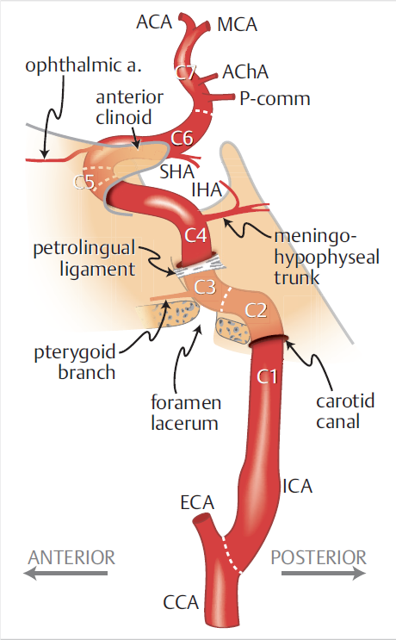
C3, Lacerum segment: It is a short segment beginning above foramen lacerum occluding the foramen lacerum (not through it!) and ends at the petro-lingual ligament. This anatomical structure is located on the wall of the cavernous sinus.
C4, Cavernous segment: This segment at first ascend towards posterior clinoid process of the sphenoid bone and then passes forward by the side of body of sphenoid bone curving upward towards the anterior clinoid process perforates the dural mater forming the roof of the cavernous sinus. The curve of the cavernous segment is called carotid siphon.

Slide 13
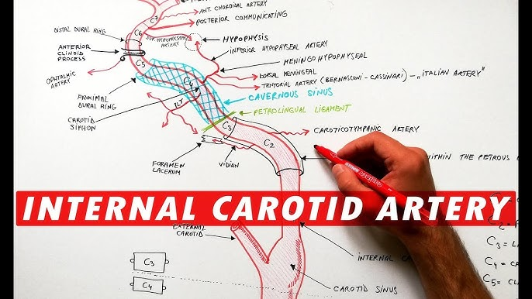
Within the cavernous sinus, the internal carotid artery travels superomedially to CN VI (abducens nerve) and medially to CN III (oculomotor nerve), CN IV (trochlear nerve), and CN V1 and CN V2 (ophthalmic and maxillary divisions of the trigeminal nerve, respectively).
Branches here are; menigiohypophysial artery, inferior lateral branch with also small capsular arteries supplying the cavernous wall.

Slide 14
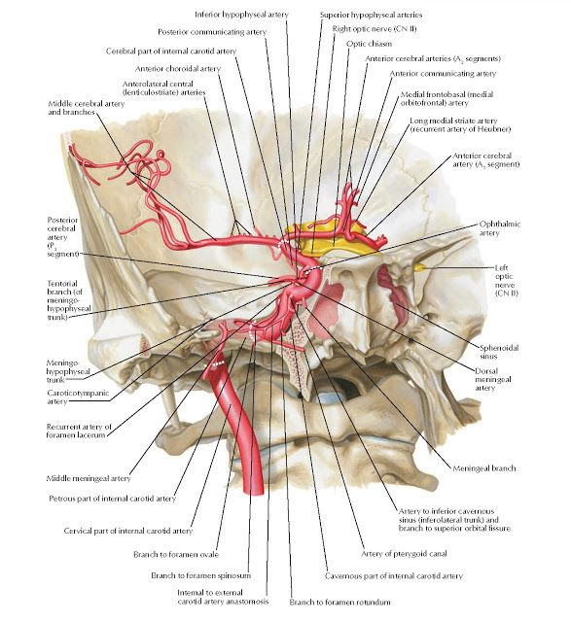
C5, Clinoid segment: After exiting the cavernous sinus at the proximal dural ring, this segment travels a very short distance until the distal dural ring. After which the artery is considered intra-dural and has entered the subarachnoid space. No branch arises here though ophthalmic may.
C6, Ophthalmic segment: From the distal dural ring, the C6 segment travels parallel and horizontal in an inferolateral position with respect to CN II (optic nerve). The end point is the origin of the posterior communicating artery.
Branches include the ophthalmic artery and the superior hypophyseal artery.

Slide 15
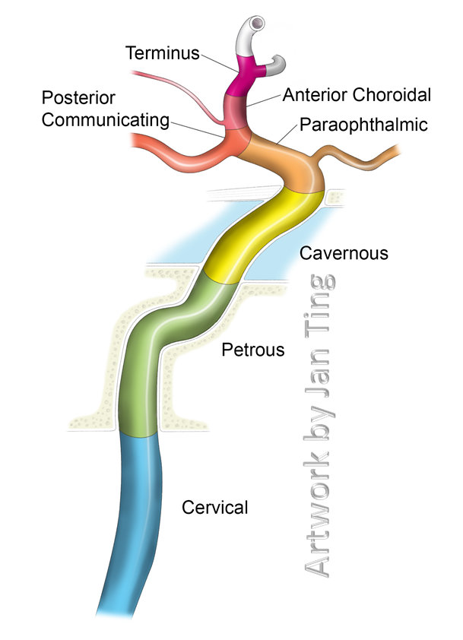
C7, Communicating segment: From the proximal origin of the posterior communicating artery to the internal carotid bifurcation.
Branches include:
Posterior communicating artery,
Anterior choroidal artery,
Anterior cerebral artery,
Middle cerebral artery.

Slide 16
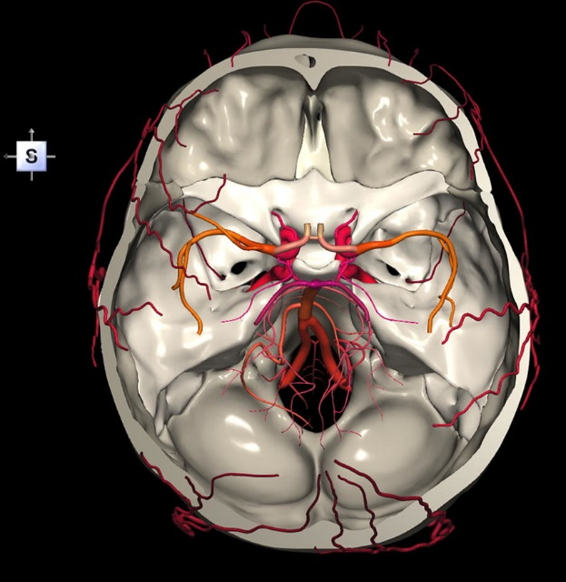

Slide 17
Clinical Significance:
Stroke and TIA: Due to its vital role in supplying the brain, blockages or narrowing (stenosis) of the ICA from atherosclerosis can lead to transient ischemic attacks (TIAs) or stroke.
Atherosclerosis: It is a common site for atherosclerosis, where plaque builds up, narrowing the artery and reducing blood flow to the brain.
Aneurysm: The artery can develop an aneurysm, a weak spot that bulges and can rupture.
Carotid artery disease is a disorder of the common carotid artery or either of its main divisions. It occurs when growths start to form in these major arteries and limit the amount of blood that flows to the head and neck region. This ailment can become extremely serious, because it can cause ischemia to vital organs such as the brain and it also increases the risk of clot formation.

